Slide 1
Influence
STAT 341
By: Sheen Thusoo | 20728766

Slide 2
What is influence?
How can we evaluate a population attribute a(P)?
One way: We can measure the effect that removing the variate value for a unit, y_{u}, has on the attribute
This is called the influence of that variate value
Mathematically, the influence is computed using the following equation:
where the attribute is evaluated including unit u and is subtracted by the attributed evaluated not including u
We calculate this equation for every unit in the population
Notes:
If we want to evaluate a population attribute, we can calculate the influence of the variate value for each unit in the population. We can measure the effect that removing a variate value has on this attribute. We can compute the influence of a variate y_u using the equation presented here. In the first part, we are evaluating the population attribute including variate y_u and we are subtracting this by the population attribute calculated without variate y_u. We want to calculate the influence for each variate value in the population. For example, say our attribute is the population average. We first calculate the average with all variate values, and we subtract from this the average not including y_u. We can do this for every variate y_u to see how much of an influence each variate value has on the population average.

Slide 3
Why use influence?
Influence is a measure that is often used for outlier detection
Usually, most variate values in a population have a similar influence value but if one variate value y_{u} has a very different influence measurement this can give us information
This value may be an error so we may need to explore it further
Since it is very different from other values, it may be an interesting unit to investigate further
Notes:
Influence is often used for outlier detection.
If we find any units that have very different influence values, we should investigate them further because they could
Be an error that should be corrected
Be a very interesting unit to look into further

Slide 4
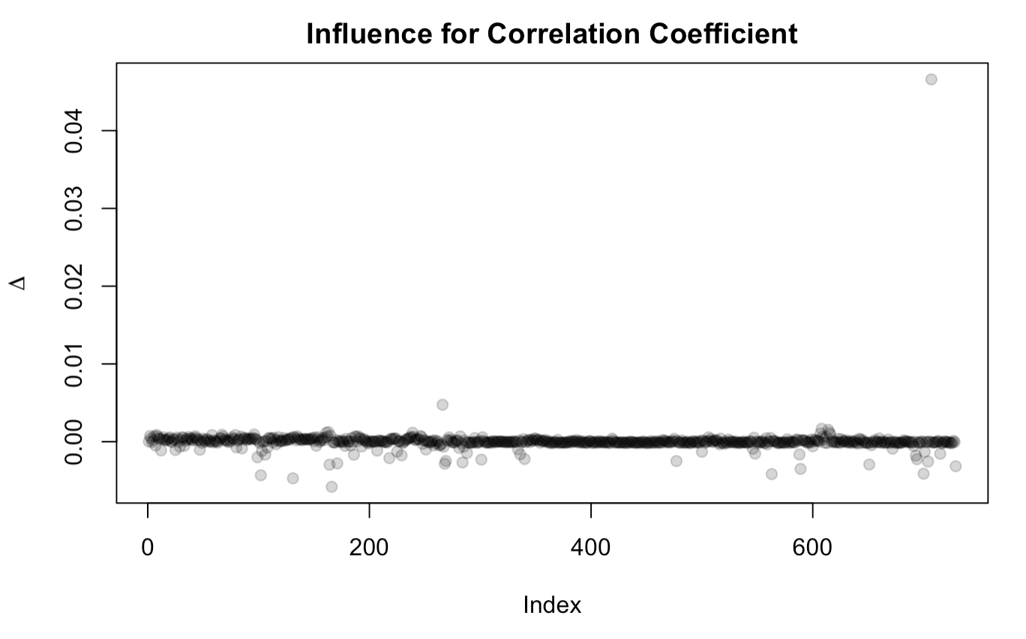
Influence plot
Notes:
Here is an example of an influence plot from question 1 d)
- Here we calculate the influence on the correlation coefficient between population and commute fraction
On the x-axis we have the index value of each unit and on the y-axis we have the influence value
We can see that for most units, we have a similar influence value of around 0
However, one variate has an influence of more than 0.04, this is clearly much different and should be investigated more
When we look into this variate value further we see that it represents the LA where the population is over 16 million and the fraction of workers with a commute of less than 15 minutes is 0.225.
This much different than other communities of similar population size which have a much lower commute fraction value.
thus, the influence of this unit is much larger on the correlation coefficient of these two variates

